Slide 1
Early Detection of Alzheimer’s disease
Ramin Nourizadeh

Slide 2
Table of Contents
Introduction to Protein
Recent advances in protein design,
shifting from a physical-based function paradigm to one that uses deep learning
Discuss challenges to the design of marketable proteins with controllable properties.

Slide 3
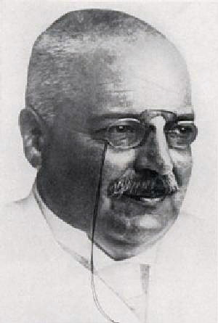
Introduction
AD
Alois Alzheimer
Notes:
Alois Alzheimer (1864 –1915) was a German psychiatrist and neuropathologist

Slide 4
Introduction
Stages Of Disease:
Normal
Very Mild Dementia
Mild Dementia
Moderate Dementia
Severe Dementia
Notes:
probability of Aβ positivity of up to 0.75 for patients with MCI and of 0.60 for SCD subjects
approximately 15–20% of MCI patients progressing to AD each year
Very Mild Dementia: Cognitive decline is noticeable but does not interfere with daily activities.
Mild Dementia: Cognitive decline is noticeable and begins to interfere with daily activities.
Moderate Dementia: Cognitive decline is significant and interferes with daily activities such as dressing and bathing.
Severe Dementia

Slide 5
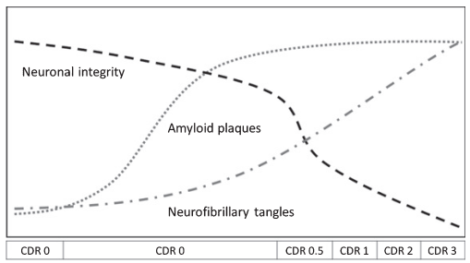
Introduction
AD diagnosis methods
Amyloid-beta (Aβ)
up to 20
Notes:
Clinical Dementia Rating

Slide 6
Introduction
Alzheimer
30% of people are misdiagnosed
Mentioning the type of MCI
aMCI affects the hippocampus and is detectable in MRI while it is not easy for naMCI.
naMCI via an EEG-based biomarker can be more valuable
Notes:
MCI همیشه به زوال عقل منجر نمی‌شود، بلکه گاهی اوقات ثابت می‌ماند یا حتی زمانی که فرد به شرایط طبیعی خود بازگشت، علائم آن از بین می‌رود. متخصصان اختلال شناختی خفیف را به دو نوع "aMCI" و "naMCI" تقسیم کردند. نوع اول به اختلالی گفته می‌شود که بر حافظه اثر می‌گذارد، در حالی که نوع دیگر ، توانایی‌های ذهنی را تحت تاثیر قرار می‌دهد. موضوع قابل توجه اینکه aMCI، خطر ابتلا به بیماری آلزایمر را بیشتر از نوع دیگر افزایش می‌دهد.

Slide 7
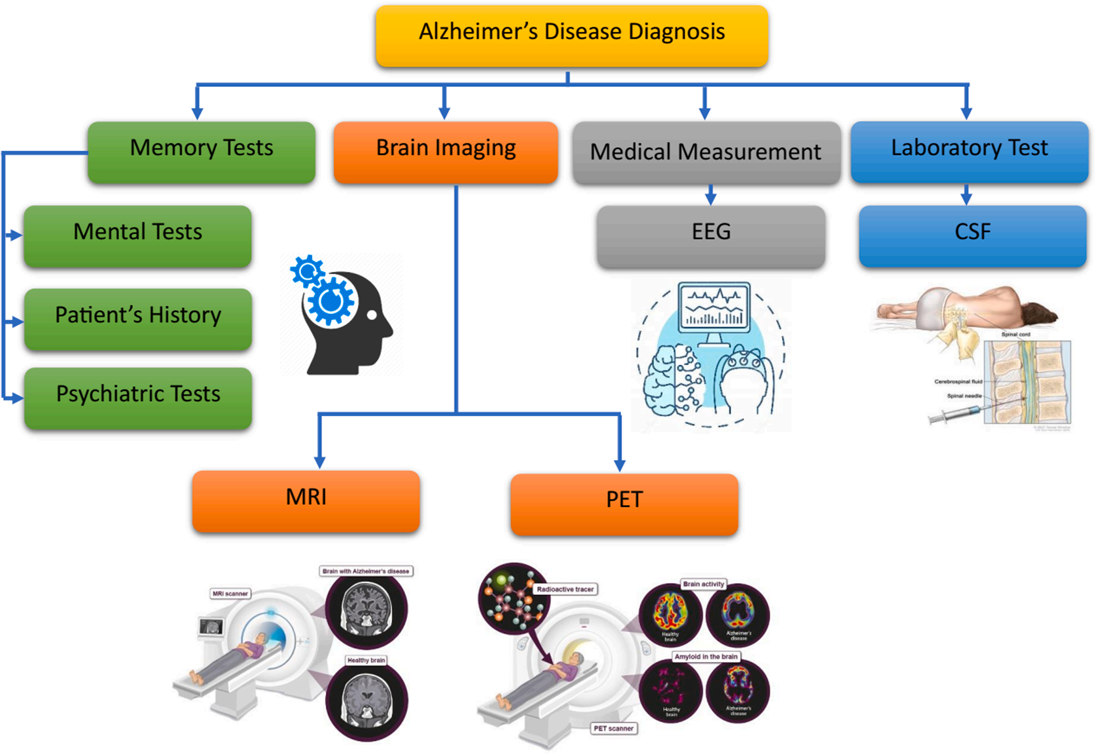
Introduction
AD diagnosis methods
Notes:
A **SPECT scan** is a type of imaging test that uses a radioactive substance and a special camera to create 3D pictures

Slide 8
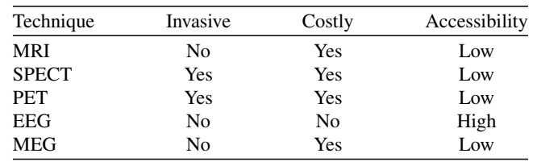
Introduction
AD diagnosis methods
Comparison of the medical techniques

Slide 9
Introduction
AD diagnosis methods
Medical imaging techniques
Voxels and features are extracted
EEG is processed in the time and the frequency domains.
MRI, CT, and PET, EEG recording methods provide good temporal resolution

Slide 10
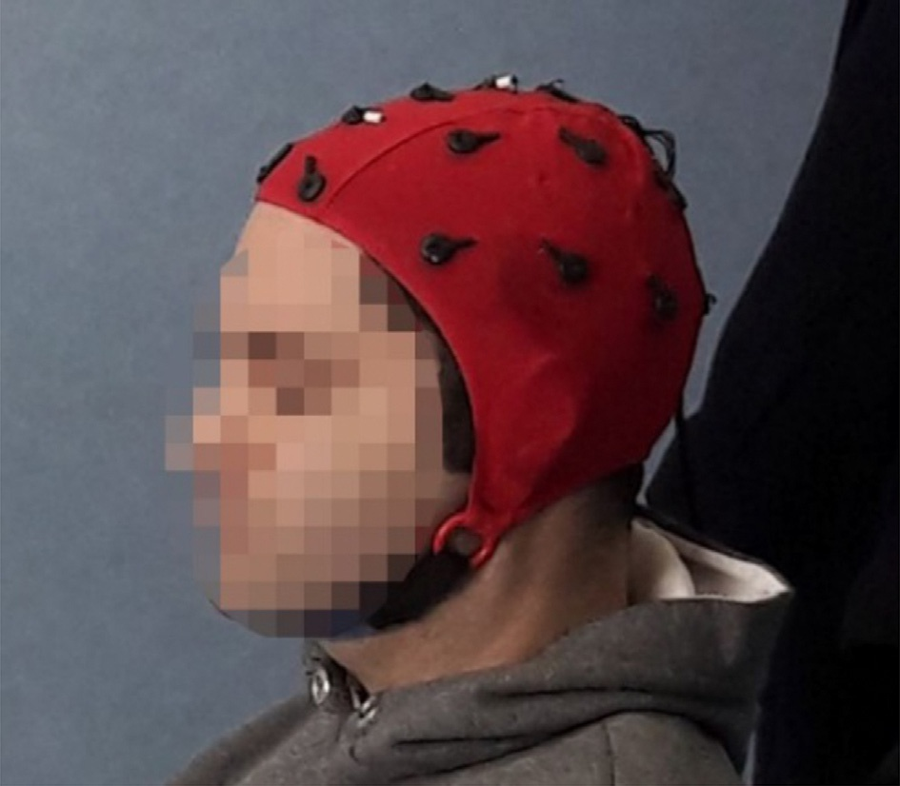
Introduction
EEG
Electroencephalography signals (EEG)
Detecting electrical activity in the brain
Notes:
The distances between adjacent electrodes are either 10% or 20% of the total front-back (nasion-inion) or right-left distance of the skull. large interelectrode distance.

Slide 11
Introduction
EEG
EEG Disadvantages
noisy raw data
low spatial resolution
Artifacts
power line, bad electrode contact and broken electrodes
Eye movements, muscle activity, and cardiac signals

Slide 12
Introduction
EEG Processing
Stages:
Data acquisition
Signal denoising
Feature extraction
Classification.

Slide 13
Introduction
EEG Recording
200 Hz
In a 10-min eye-closed resting state
Participants were required to remain awake during the entire recording
Capture neural events in milliseconds
spatial resolution is limited by the number of electrodes
Notes:
200 Hz refers to the sampling rate at which electrical activity in the brain is measured . It means that **200 samples per second

Slide 14
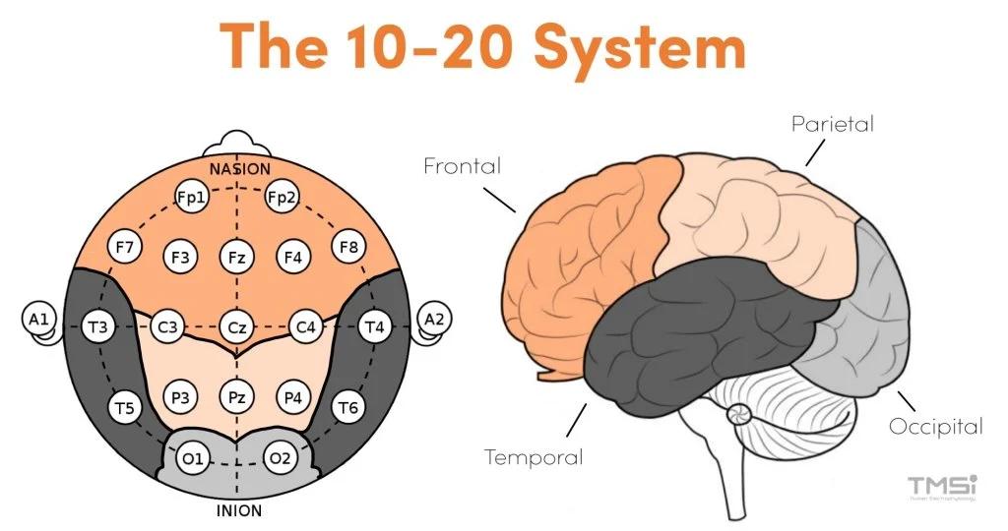
Introduction
EEG Recording
Notes:
The distances between adjacent electrodes are either 10% or 20% of the total front-back (nasion-inion) or right-left distance of the skull. large interelectrode distance.

Slide 15
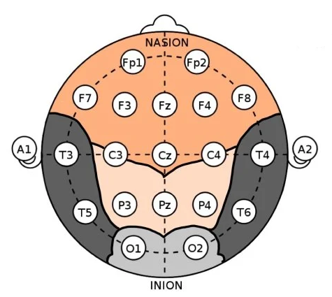
Introduction
EEG Recording
T3, T4, T5, and T6 channels in classification of HC, AD, and MCI.
FP2, Fz,F3, Pz, and T5 channels in MCI classification
Notes:
The distances between adjacent electrodes are either 10% or 20% of the total front-back (nasion-inion) or right-left distance of the skull. large interelectrode distance.

Slide 16
Introduction
EEG Recording
Notes:
The distances between adjacent electrodes are either 10% or 20% of the total front-back (nasion-inion) or right-left distance of the skull. large interelectrode distance.

Slide 17
Introduction
EEG Recording
Notes:
The distances between adjacent electrodes are either 10% or 20% of the total front-back (nasion-inion) or right-left distance of the skull. large interelectrode distance.

Slide 18
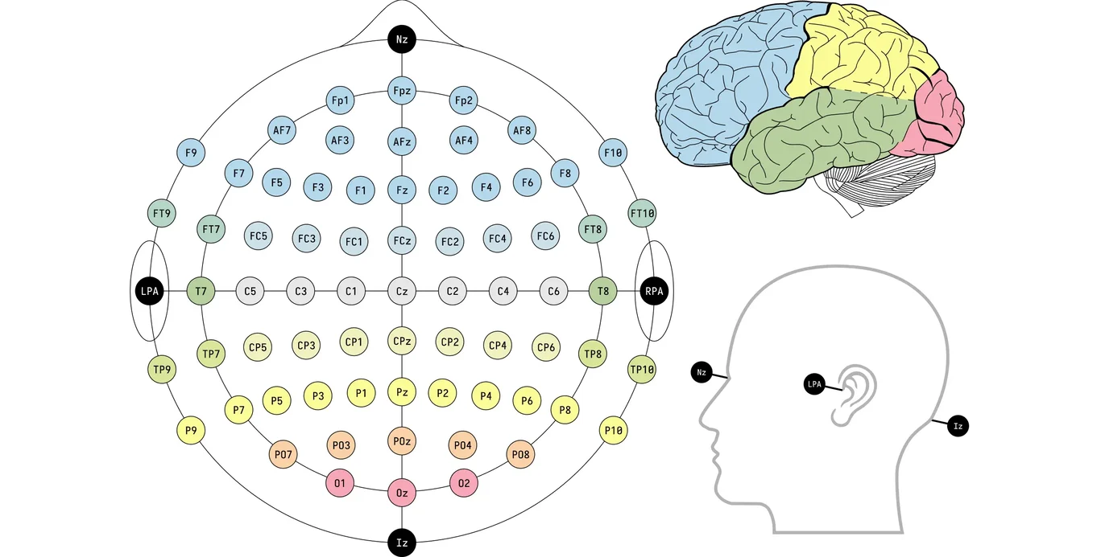
Introduction
EEG Recording
10-10 system

Slide 19
Introduction
EEG Recording
10-10 system

Slide 20
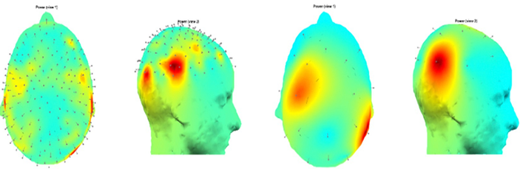
Introduction
EEG Recording
3D scalp topography of the power of the EEG recording is shown

Slide 21
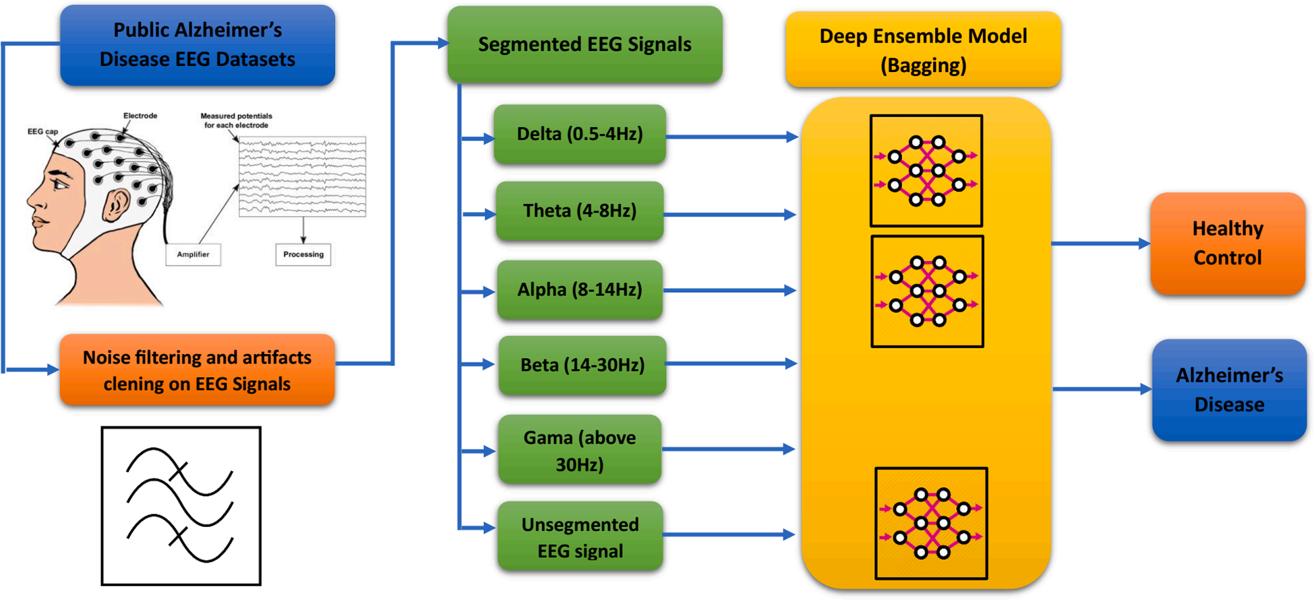
Introduction
EEG Processing
Block diagram AD diagnosis DEL model

Slide 22
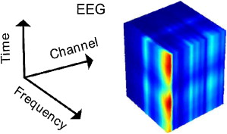
Introduction
EEG Preprocessing
Filtering and EEG rhythm calculation
Artifact reduction algorithms
Expert supervision
Data reduction
Source localization
Data augmentation
Normalization, and input generating for Deep Neural Network (DNN)

Slide 23
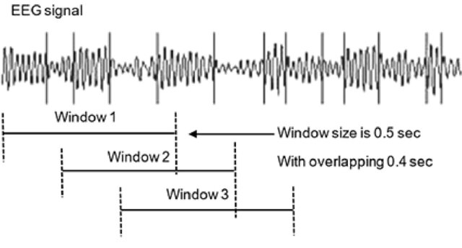
Introduction
EEG Preprocessing
Determining of the window size
Notes:
last procedure in the pre-processing stage is determining of the window size . It should be long enough to be informative about the dynamic of the system and fulfill the processing method. Long processing windows, on the other hand, can increase the computational cost. Therefore, finding a fit window size is an art.

Slide 24
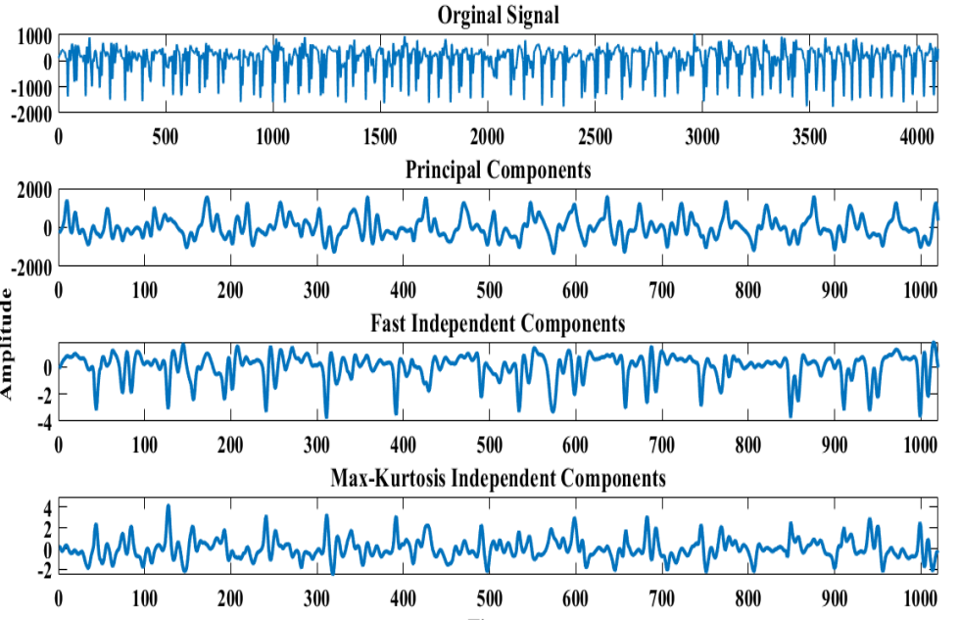
Introduction
EEG Preprocessing
Dimension reduction

Slide 25
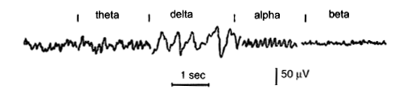
Introduction
EEG Preprocessing
Delta: has a frequency of 3 Hz or below
Theta: has a frequency of 3.5 to 7.5 Hz
Alpha: has a frequency between 7.5 and 13 Hz
Beta: : has a frequency between 13 and 25 Hz

Slide 26
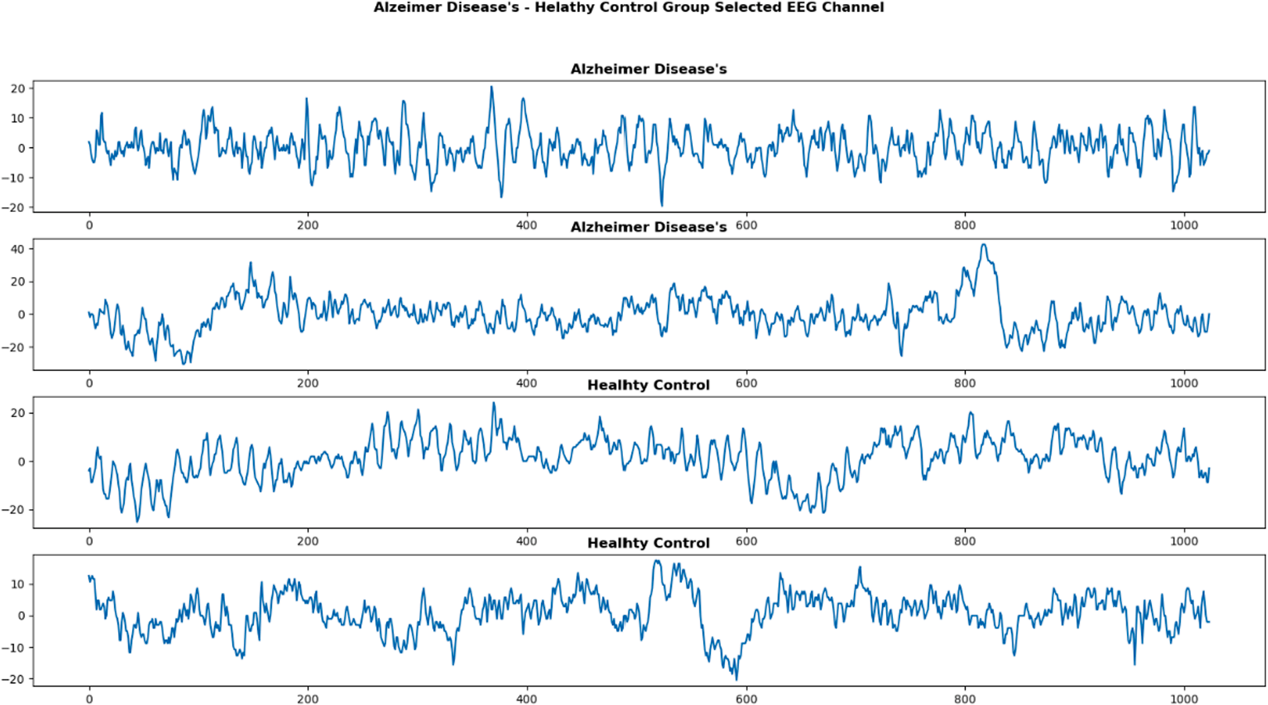
Introduction
EEG Processing
Alzheimer Disease’s (AD) – Healthy Control (HC) Group EEG signals.

Slide 27
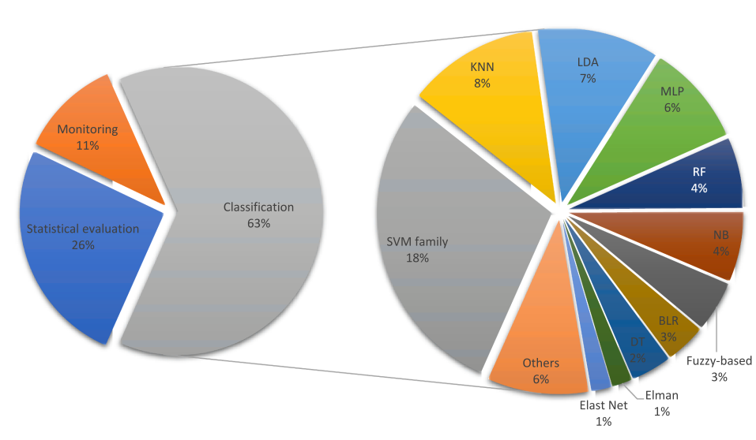
Introduction
Alzheimer
Pie chart of the percentages of Decision-making approaches.
Notes:
Abbreviations: Support Vector Machine (SVM), K-Nearest Neighbor (KNN), Linear Discriminant Analysis (LDA), Multilayer Perceptron (MLP), Random Forest (RF), Naïve Bayse (NB), Binary Logistic Regression (BLR), Decision Tree (DT)

Slide 28
Introduction
EEG Processing
Deep learning techniques in AD assessment:
Convolutional neural network (CNN)
MC-DCNN (Multi-Channel Deep Convolutional Neural Network )
AlexNet
Stacked autoencoder (SAE)
Spatial Temporal Convolutional Networks (ST-CNN)

Slide 29
Introduction
EEG Processing
A wavelet transform reveals important information in a signal’s time–frequency domain through analysis of frequency components.

Slide 30
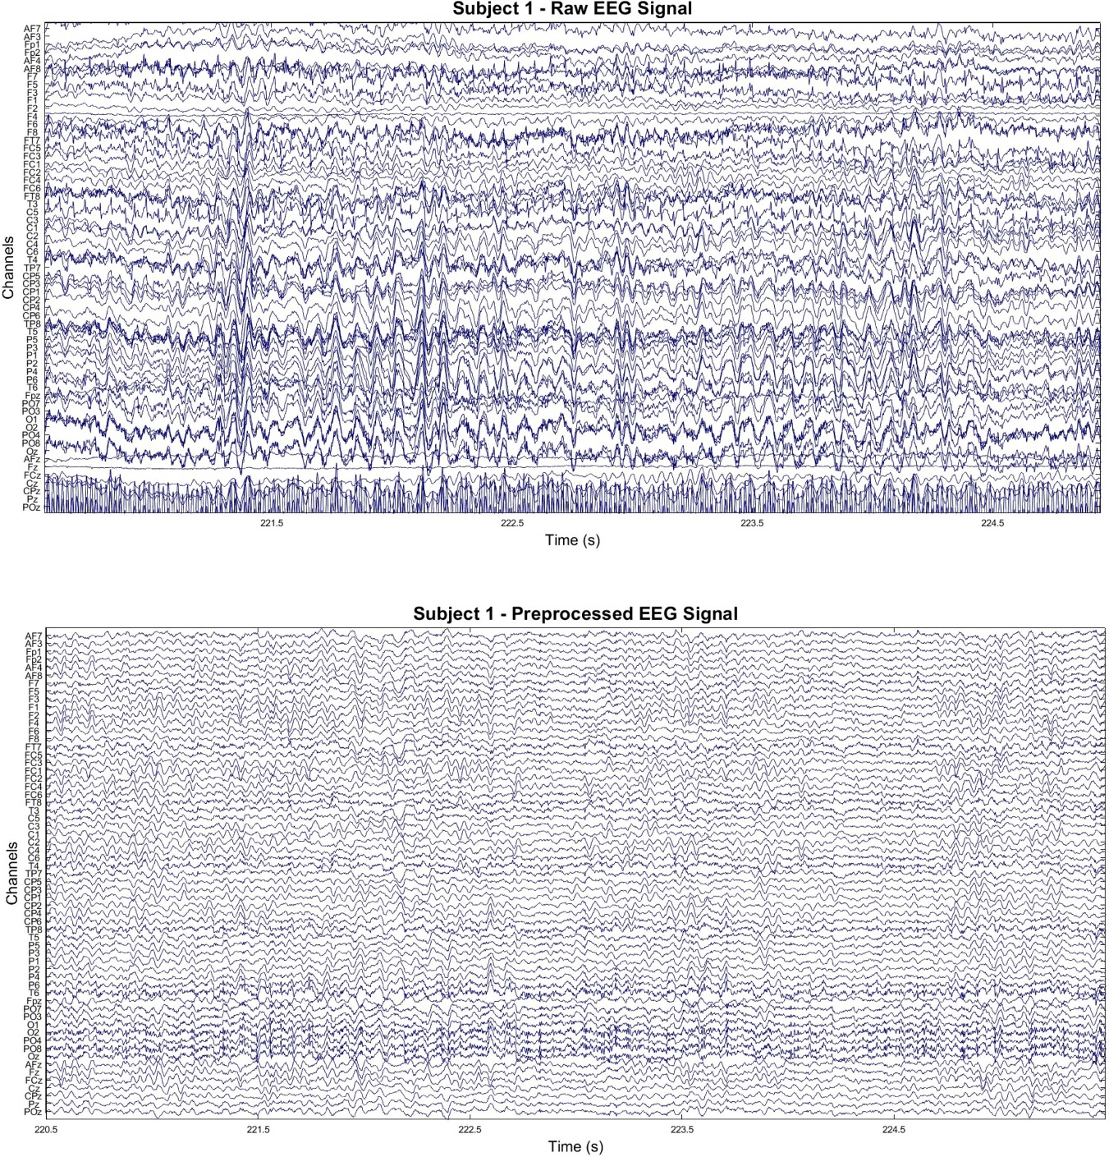
Introduction
EEG Processing
Sample EEG recordings
Notes:
(top) 5 s window of raw EEG signal. (bottom) Same window after preprocessing.

Slide 31
Introduction
EEG Feature Extraction
Transformed to the frequency domain using
Fourier methodology such as Fast Fourier Transform (FFT)
Welch Power Spectral Density (PSD) analysis
Transformed to the time-frequency domain using decomposition such as
Discrete Wavelet Transform (DWT) **
Empirical Mode Decomposition (EMD)
Notes:
Almost all the studies have employed band pass filter or discrete wavelet transform (DWT) to remove some artifacts that lie in a limited frequency band or specific artifacts
right choice of the feature selection method removed up to 82% of the EEG spectral features and increased the accuracy of the classifier more than 17%

Slide 32
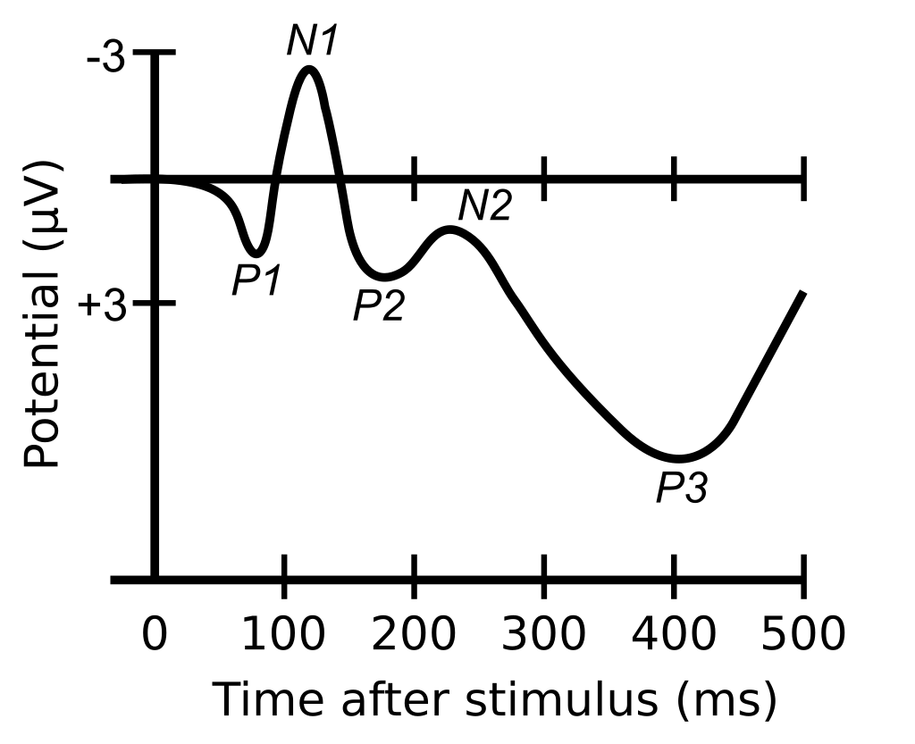
Introduction
EEG Time domain features
Event-related potentials (ERP)
ERP are electric potentials elicited in the brain as a response to an auditory or visual stimulus.
Complexity
Lower complexity and irregularity compared to HC

Slide 33
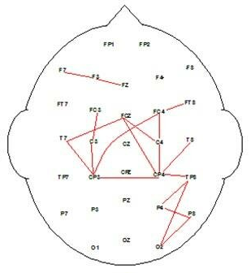
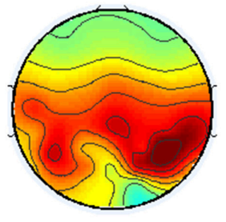
Introduction
EEG Frequency domain analysis
Coherence
This metric evaluates the synchrony between two signals
Increase of coherence in delta and theta rhythms, and a decrease in alpha and beta rhythms in MCI and AD
Relative power
This metric quantifies the proportion of power that is contained in an EEG sub band, compared to the total power of the signal.
Relative power in the fast rhythms (alpha and beta) decreases, while the relative power in the slow rhythms (delta and theta) increases.
Notes:
Coherence
This metric evaluates the synchrony between two signals. More formally, coherence refers to the normalized covariance of two signals in the spectral domain. In literature, authors have reported an increase of coherence in delta and theta rhythms, and a decrease in alpha and beta rhythms in MCI and AD
Relative power
This metric quantifies the proportion of power that is contained in an EEG sub band, compared to the total power of the signal. This means that the relative power in the fast rhythms (alpha and beta) decreases, while the relative power in the slow rhythms (delta and theta) increases.

Slide 34
Introduction
EEG Frequency domain analysis for AD detection
Fourier transform
Wavelet transform
Amplitude modulation
Combines temporal and frequency analysis
Notes:
This transform is used to decompose a time signal into a sum of sines and cosines of different frequencies and infinite length. spectral content of the EEG cannot be tracked by the Fourier transform, as the sines and cosines used in this transform are infinite length. Conversely, the

Slide 35
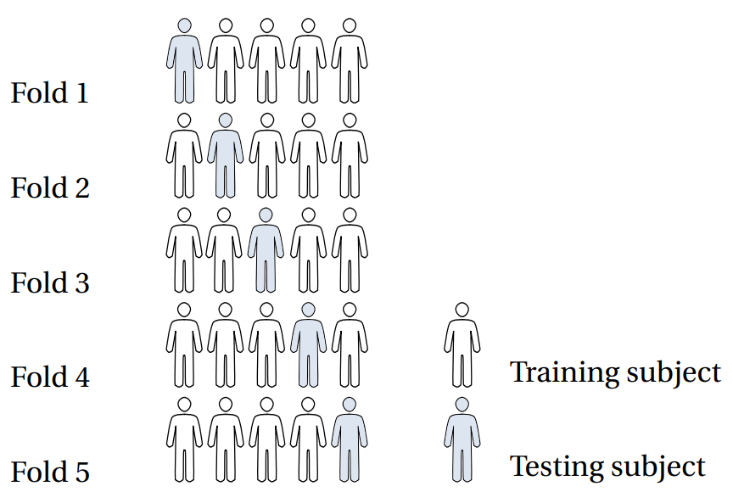
Introduction
performance evaluation methods
LOSO CV (Leave-One-Out Cross-Validation)
Splitting a dataset into a training set and a testing set
Using all but one observation as part of the training set
Notes:
A model is then built using only data from the training set, and the model is used to predict the response value of the one observation left out of the model. This process is repeated n times

Slide 36
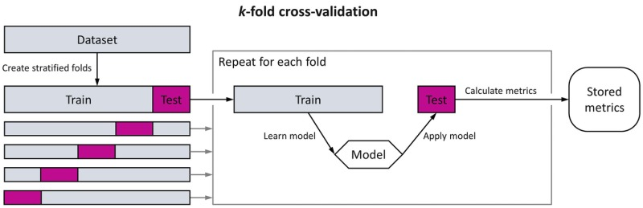
Introduction
performance evaluation methods
K-fold
Dataset is randomly split into k equal-sized folds
Each fold is then used as a test set once, while the remaining k-1 folds are used as the training set
This process is repeated k times, with each fold serving as the test set exactly once.

Slide 37
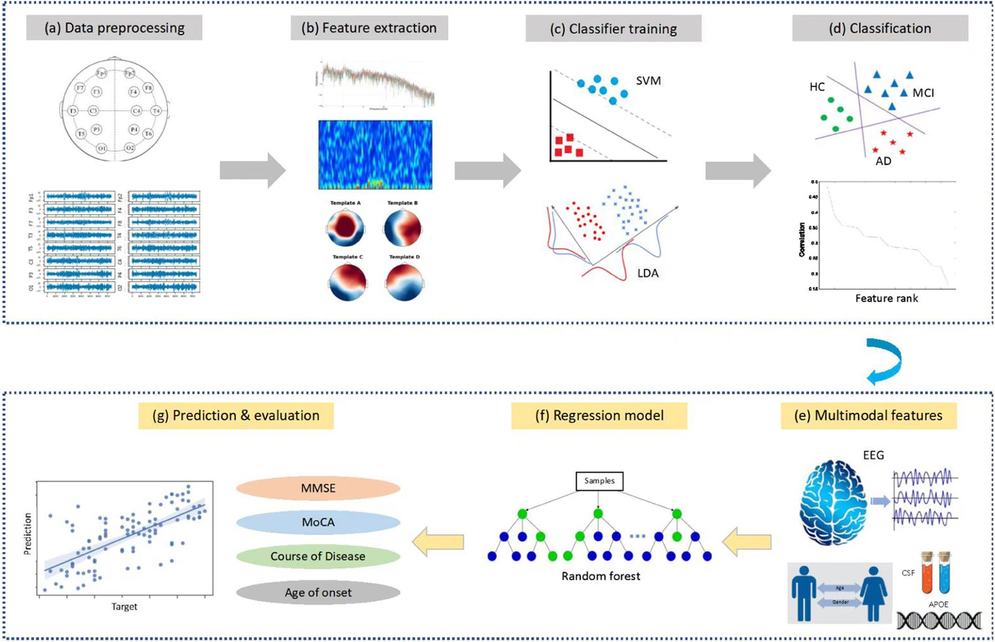
Methods
Overview
890 participants
189 MCI
330 AD
125 other dementias
246 Healthy
Jiao B, Li R, Zhou H, Qing K, Liu H, Pan H, et al. Neural biomarker diagnosis and prediction to mild cognitive impairment and Alzheimer’s disease using EEG technology. Alzheimer's Research & Therapy. 2023;15(1):32.
Notes:
Datasets are available from the corresponding author upon reasonable request

Slide 38
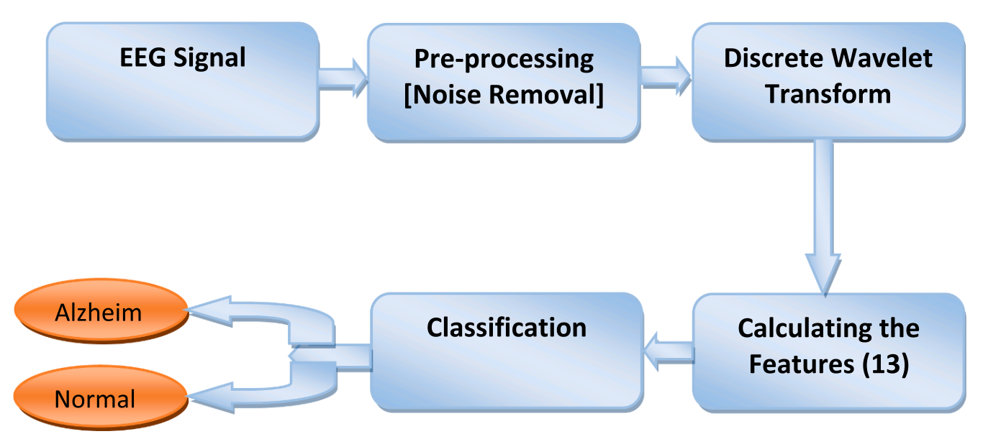
Methods
Use three central lobe electrodes
Dataset
7 MCI
59 AD
102 NC
Performance is 96.55%
Fouad IA, El-Zahraa M. Labib F. Identification of Alzheimer’s disease from central lobe EEG signals utilizing machine learning and residual neural network. Biomedical Signal Processing and Control. 2023;86.
Notes:
This EEG dataset is available as open source.

Slide 39
Methods
Using a Dual-Input Convolution Encoder Network
Public dataset from Department of Neurology of AHEPA General University Hospital of Thessaloniki
36 AD
23 Frontotemporal dementia (FTD)
29 CN
Miltiadous A, Gionanidis E, Tzimourta KD, Giannakeas N, Tzallas AT. DICE-Net: A Novel Convolution-Transformer Architecture for Alzheimer Detection in EEG Signals. IEEE Access. 2023;11:71840-58.

Slide 40
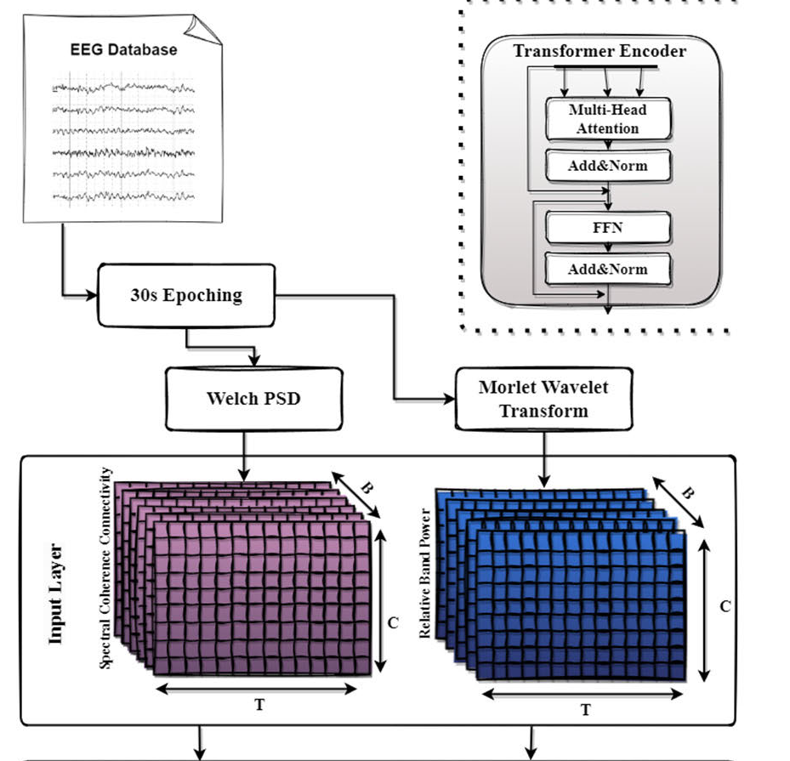
Methods
Extract two biomarkers
Relative Band Power (RBP): increase in Theta/Alpha ratio in AD patients
Spectral Coherence Connectivity (SCC): decreased synchronization likelihood in AD patients
Express them in image-like representations (3d matrixes)
Miltiadous A, Gionanidis E, Tzimourta KD, Giannakeas N, Tzallas AT. DICE-Net: A Novel Convolution-Transformer Architecture for Alzheimer Detection in EEG Signals. IEEE Access. 2023;11:71840-58.
Notes:
First, each recording was divided into 30-second time windows with 15 seconds overlap to create the pool of EEG signals that will be used for the classification task. Next, the following two features have been extracted

Slide 41
Methods
Preprocessing pipeline
Butterworth band-pass filter 0.5-45 Hz
Re-referenced to A1-A2
Automatic artifact reject method
ASR
Miltiadous A, Gionanidis E, Tzimourta KD, Giannakeas N, Tzallas AT. DICE-Net: A Novel Convolution-Transformer Architecture for Alzheimer Detection in EEG Signals. IEEE Access. 2023;11:71840-58.
Notes:
First, each recording was divided into 30-second time windows with 15 seconds overlap to create the pool of EEG signals that will be used for the classification task. Next, the following two features have been extracted

Slide 42
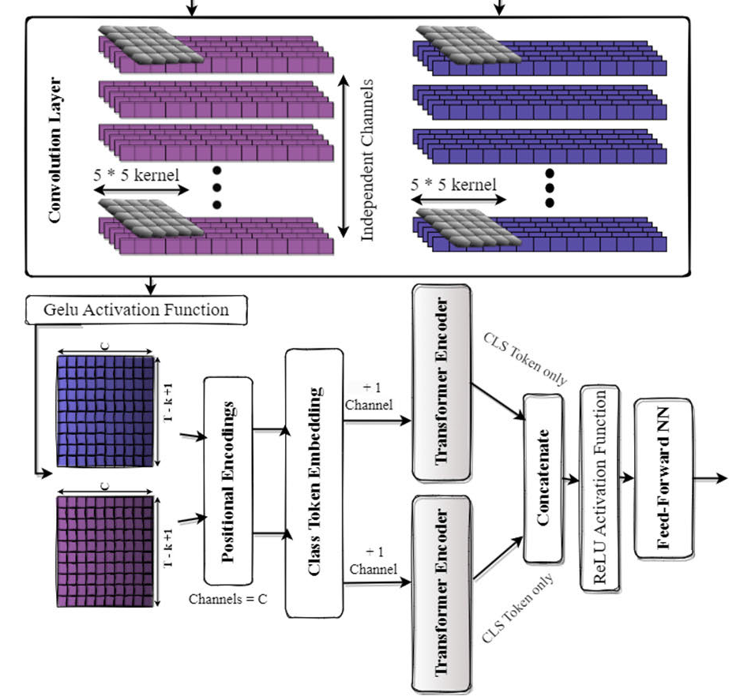
Methods
Fed in 2 parallel Convolution blocks
Accuracy of 83.28% LOSO validation
Miltiadous A, Gionanidis E, Tzimourta KD, Giannakeas N, Tzallas AT. DICE-Net: A Novel Convolution-Transformer Architecture for Alzheimer Detection in EEG Signals. IEEE Access. 2023;11:71840-58.

Slide 43
Methods
Two datasets were used
Divides EEG signals into 5 frequency bands with a Butterworth band-pass filter
Signals recorded as 8 s in the datasets were segmented into 1 s epochs
An epoch was converted into a 2D array of 128x19. A total of 1120 epochs consist of two datasets combined
Then, EEG signals for each frequency band (delta, theta, alpha, beta, and gamma) were segmented into 1 s epochs (128x19 2D array) and given as input to ensemble learning
Accuracy of 97.9%
Nour M, Senturk U, Polat K. A novel hybrid model in the diagnosis and classification of Alzheimer's disease using EEG signals: Deep ensemble learning (DEL) approach. Biomedical Signal Processing and Control. 2024;89.
Notes:
We can send the datasets at the request of the authors

Slide 44
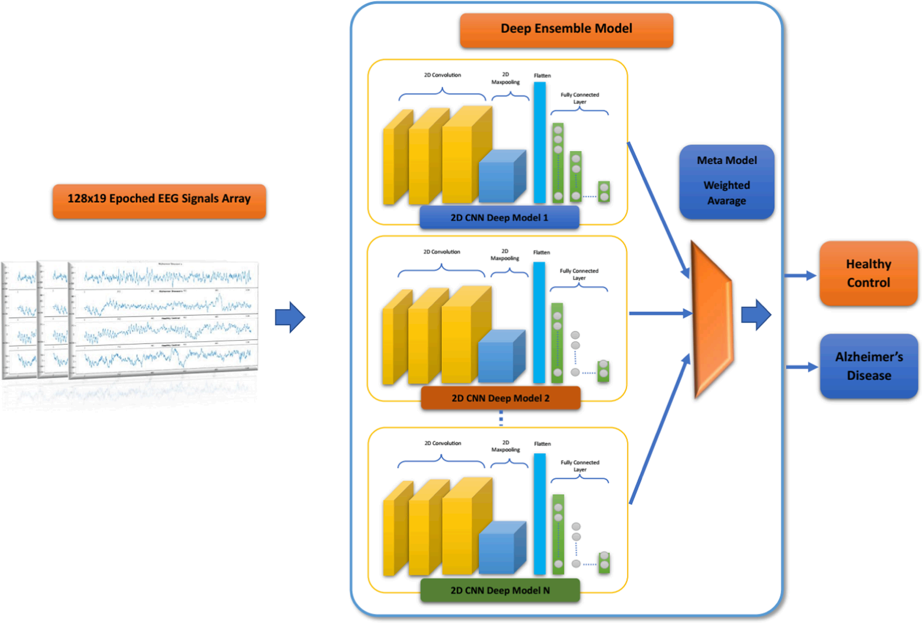
Methods
The proposed Deep Ensemble Learning
Nour M, Senturk U, Polat K. A novel hybrid model in the diagnosis and classification of Alzheimer's disease using EEG signals: Deep ensemble learning (DEL) approach. Biomedical Signal Processing and Control. 2024;89.

Slide 45
Methods
Transformers
Higher ability to deal with long-range dependencies
Recognize patterns in sequences of data
More interpretable decision-making processes
Recent efforts in exploring their applications on timeseries data, such as EEG or electromyography signals are showing interesting results
Sibilano E, Brunetti A, Buongiorno D, Lassi M, Grippo A, Bessi V, et al. An attention-based deep learning approach for the classification of subjective cognitive decline and mild cognitive impairment using resting-state EEG. Journal of Neural Engineering. 2023;20(1):016048.

Slide 46
Methods
Five different datasets were created by extracting
delta, theta, alpha, beta and delta-to-theta frequency bands using bandpass filters.
best performances
delta dataset
Performance of 0.807
Results performance with a minimum features is higher than 0.74.
Sibilano E, Brunetti A, Buongiorno D, Lassi M, Grippo A, Bessi V, et al. An attention-based deep learning approach for the classification of subjective cognitive decline and mild cognitive impairment using resting-state EEG. Journal of Neural Engineering. 2023;20(1):016048.

Slide 47
Methods
Firstly 19 channels are selected and 4 frequency bands (δ, θ, α and β) are extracted
Obtaining four distinct datasets and a fifth one using the δ-to-β range.
Perform both two- and three-class classifications of epochs through LOSOCV
Sibilano E, Brunetti A, Buongiorno D, Lassi M, Grippo A, Bessi V, et al. An attention-based deep learning approach for the classification of subjective cognitive decline and mild cognitive impairment using resting-state EEG. Journal of Neural Engineering. 2023;20(1):016048.

Slide 48
Methods
A cluster of 19 channels, namely Fp1, Fp2, F7, F3, Fz, F4, F8, T3, C3, Cz, C4, T4, T5, P3, Pz, P4, T6, O1, O2, was then selected. Since these channels evenly cover the scalp area, this EEG pattern is the most employed in the literature for similar studies [56] and has been proven to ensure sufficient quality along with possible comparison with previous rsEEG findings of other projects
Sibilano E, Brunetti A, Buongiorno D, Lassi M, Grippo A, Bessi V, et al. An attention-based deep learning approach for the classification of subjective cognitive decline and mild cognitive impairment using resting-state EEG. Journal of Neural Engineering. 2023;20(1):016048.

Slide 49
Methods
adding more spatial details by using all available 61 EEG channels, instead of a cluster of 19 channels, not only did not improve the performances of the model
Sibilano E, Brunetti A, Buongiorno D, Lassi M, Grippo A, Bessi V, et al. An attention-based deep learning approach for the classification of subjective cognitive decline and mild cognitive impairment using resting-state EEG. Journal of Neural Engineering. 2023;20(1):016048.

Slide 50
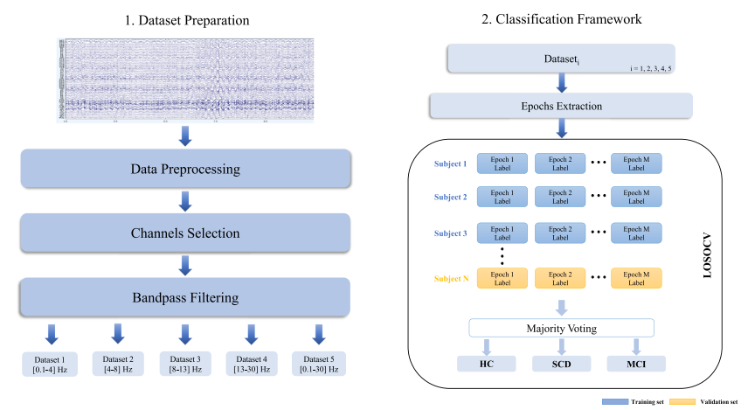
Methods
Workflow of the proposed method
Sibilano E, Brunetti A, Buongiorno D, Lassi M, Grippo A, Bessi V, et al. An attention-based deep learning approach for the classification of subjective cognitive decline and mild cognitive impairment using resting-state EEG. Journal of Neural Engineering. 2023;20(1):016048.

Slide 51
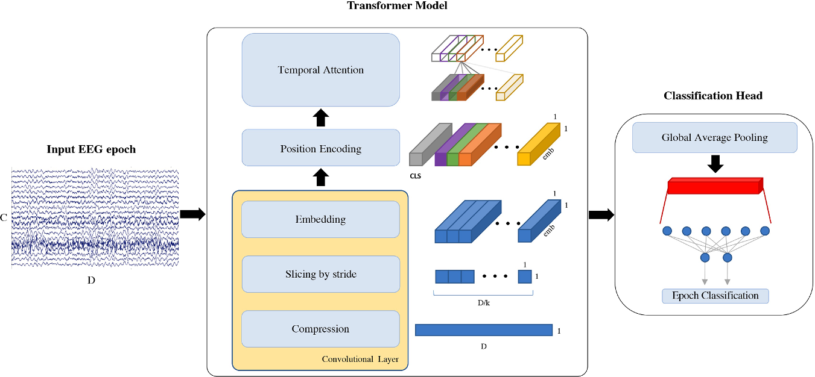
Methods
EEG epoch classification pipeline. Each EEG segment of C = 19 channels and D = 5120 datapoints is used as input to our model, which uses a convolutional layer to compress the signal, extract slices and embed the information. k = 31 is the size of the kernel, emb = 6 is the embeddings’ dimension and CLS is the classification token prepended to the input. Attention mechanism is then applied on the temporal domain and, after global average pooling, a linear layer is used to classify the input EEG epoch
Sibilano E, Brunetti A, Buongiorno D, Lassi M, Grippo A, Bessi V, et al. An attention-based deep learning approach for the classification of subjective cognitive decline and mild cognitive impairment using resting-state EEG. Journal of Neural Engineering. 2023;20(1):016048.

Slide 52
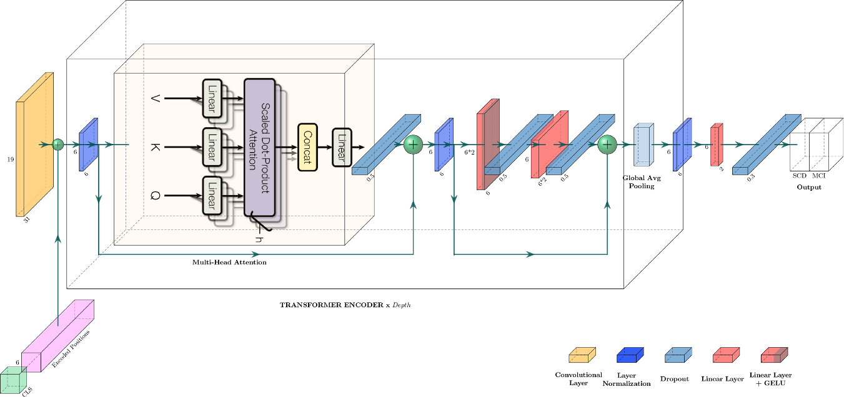
Methods
Proposed transformer architecture. CLS is the classification token, h = 3 is the number of heads used by multi-head attention and Depth = 2 indicates the number of times the transformer encoder block is repeated. A legend for uncaptioned blocks is provided on the bottom right corner
Sibilano E, Brunetti A, Buongiorno D, Lassi M, Grippo A, Bessi V, et al. An attention-based deep learning approach for the classification of subjective cognitive decline and mild cognitive impairment using resting-state EEG. Journal of Neural Engineering. 2023;20(1):016048.

Slide 53
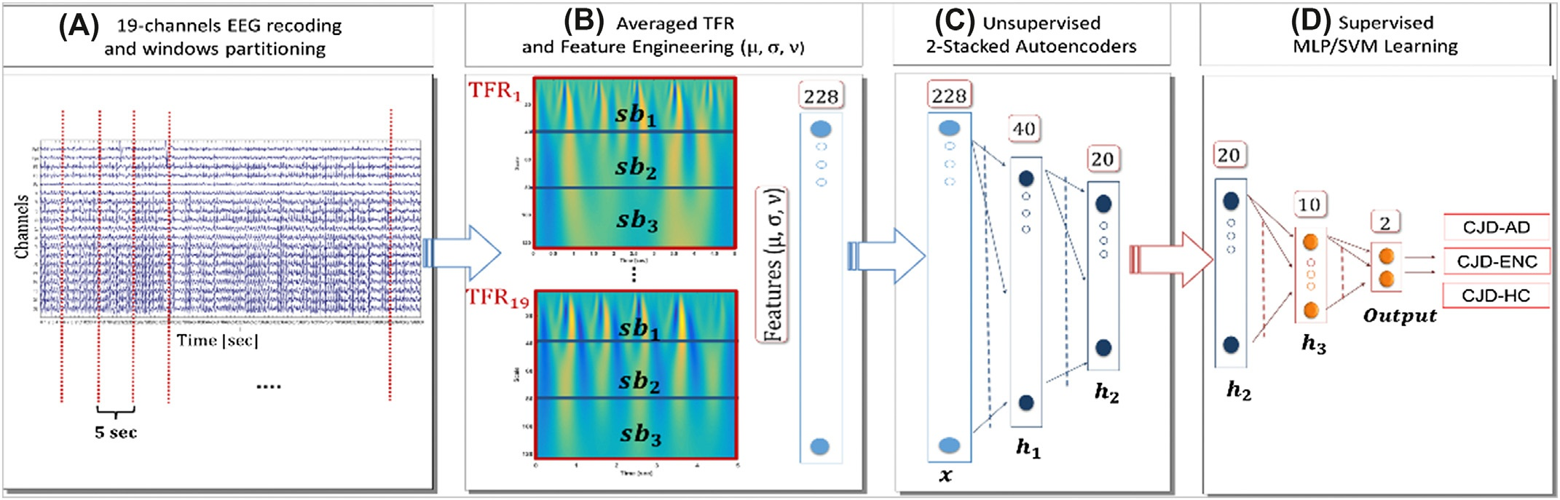
Methods
(A) The 19-channel EEG recording is partitioned into N nonoverlapping 5s windows. (B) For each EEG epoch, and for every EEG channel a time-frequency representation (TFR) is computed. The TFRs are averaged over epochs resulting in 19 averaged TFRs (one per channel). Each averaged TFR is subdivided into three subbands, and then, the mean (μ), the standard deviation (σ), and the skewness (v) are estimated both for the subbands and for the whole TFR. Therefore, 1219¼228 engineered features are extracted and are used to train 2 stacked autoencoders (UL). (C) The first autoencoder (AE1, 228:40:228) compresses the input representation in 40 parameters (h1). The second autoencoder (AE2, 40:20:40) compresses the 40 learned features in 20 higher-level paraments (h2). Finally, a classifier with a single hidden layer (h3) of 10 neurons is trained (SL)
Morabito, F. C., et al. (2017). "Deep Learning Representation from Electroencephalography of Early-Stage Creutzfeldt-Jakob Disease and Features for Differentiation from Rapidly Progressive Dementia." Int J Neural Syst 27(2): 1650039.

Slide 54
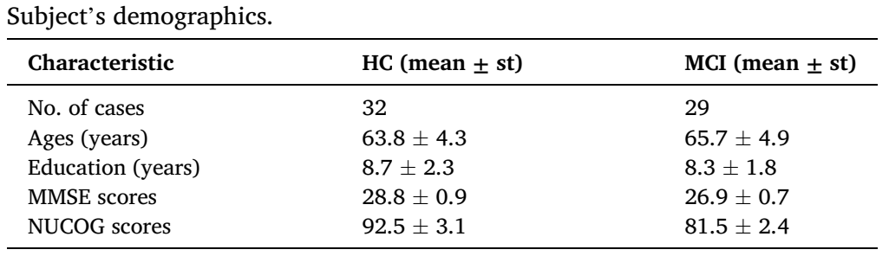
Methods
The study analyzed a total of eight EEG features obtained from 21 channels.
he study only considers the two-, four-, six-, and eight-channels under the restrictive condition of symmetric channel pairs. For example, in the case of evaluating the accuracies of two channels, the Fp1 channel is selected only with the Fp2 channel, the F7 channel is selected with only the F8, the O1 channel is selected with only the O2, and so on
The suggested methods are examined with two public datasets that are both available in [34]
Aljalal, M., et al. (2024). "Mild cognitive impairment detection with optimally selected EEG channels based on variational mode decomposition and supervised machine learning." Biomedical Signal Processing and Control 87.

Slide 55
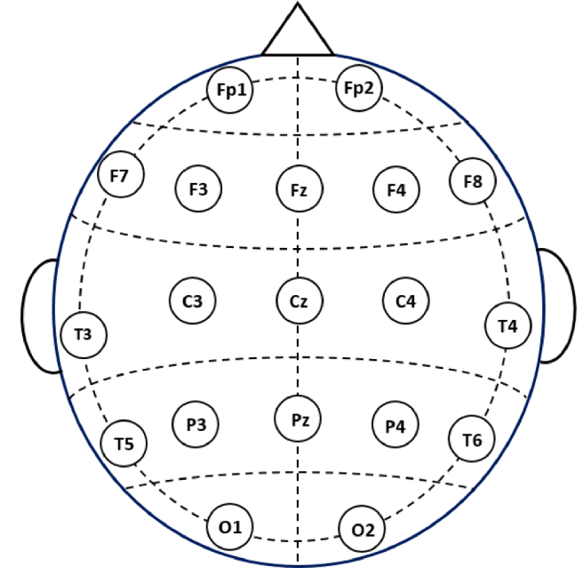
Methods
The 19 channels locations used in this study
Aljalal, M., et al. (2024). "Mild cognitive impairment detection with optimally selected EEG channels based on variational mode decomposition and supervised machine learning." Biomedical Signal Processing and Control 87.

Slide 56
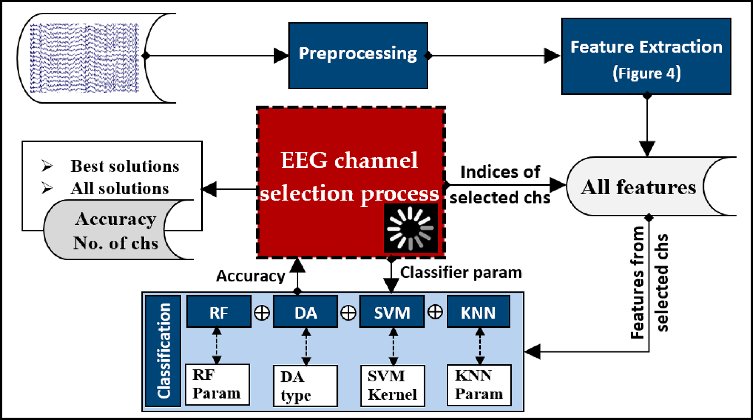
Methods
High-level overview of EEG signal processing and channel selection process
Aljalal, M., et al. (2024). "Mild cognitive impairment detection with optimally selected EEG channels based on variational mode decomposition and supervised machine learning." Biomedical Signal Processing and Control 87.

Slide 57
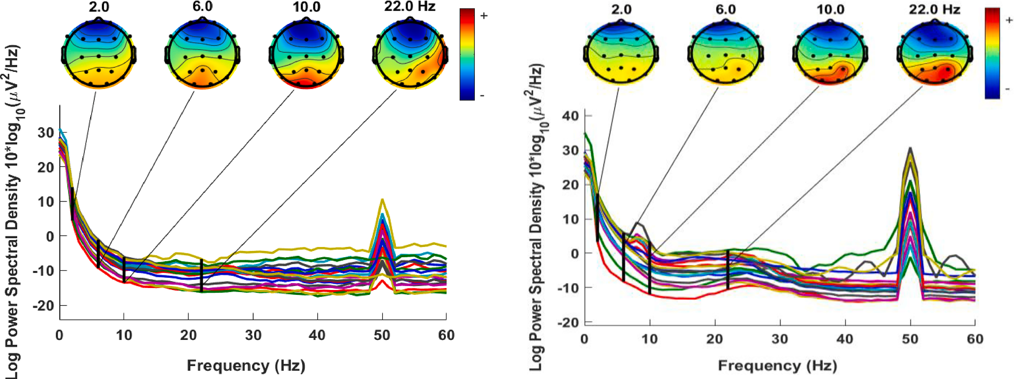
Methods
PSD and electrodes map for HC EEG (left) and MCI EEG (right).
the electrode maps are offered for four additional arbitrary frequencies: 2, 6, 10, and 22 Hz. In general, in both cases, the low-frequency spectrum has a higher power density than the high-frequency spectrum
Aljalal, M., et al. (2024). "Mild cognitive impairment detection with optimally selected EEG channels based on variational mode decomposition and supervised machine learning." Biomedical Signal Processing and Control 87.

Slide 58
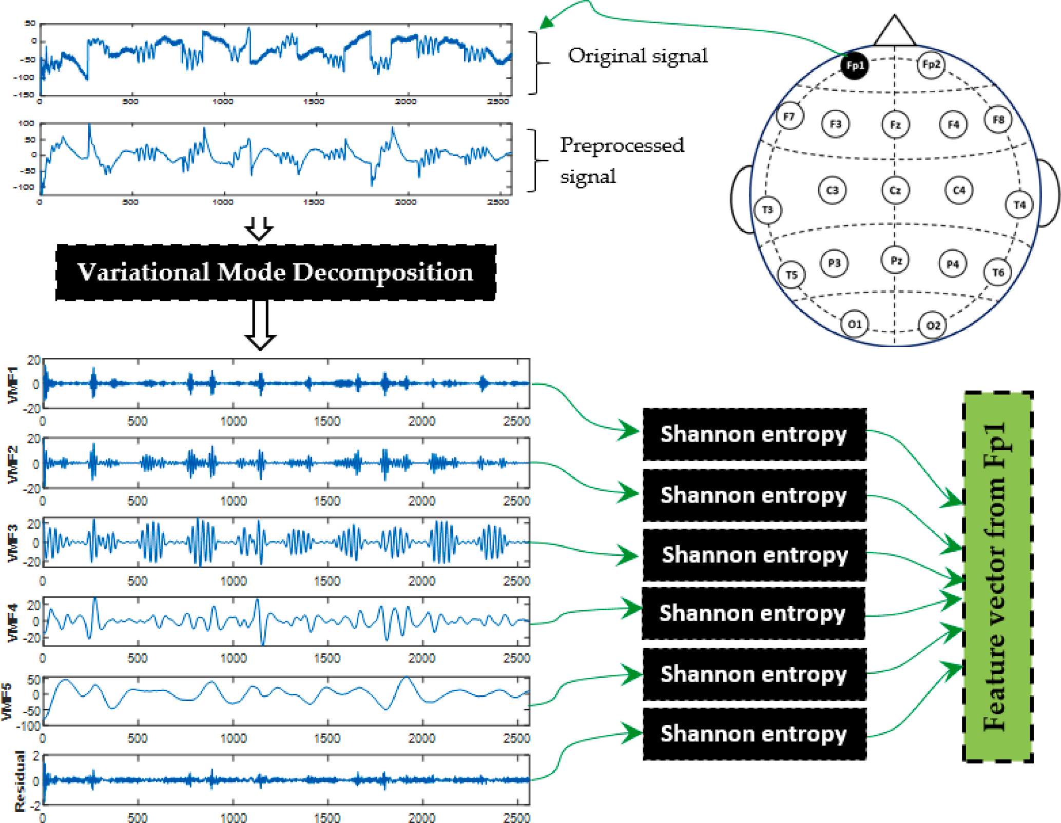
Methods
Example of feature extraction from a 10 sec segment using VMD and Shannon entropy.
Aljalal, M., et al. (2024). "Mild cognitive impairment detection with optimally selected EEG channels based on variational mode decomposition and supervised machine learning." Biomedical Signal Processing and Control 87.

Slide 59
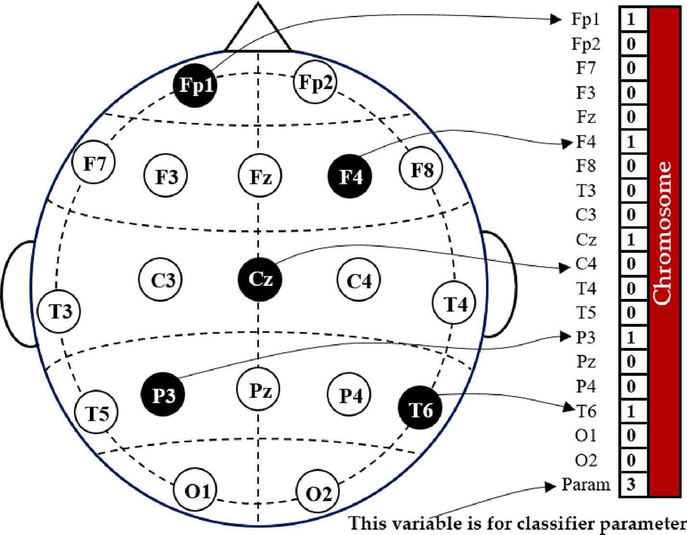
Methods
Example of channel representation in a chromosome for NSGA
Aljalal, M., et al. (2024). "Mild cognitive impairment detection with optimally selected EEG channels based on variational mode decomposition and supervised machine learning." Biomedical Signal Processing and Control 87.

Slide 60
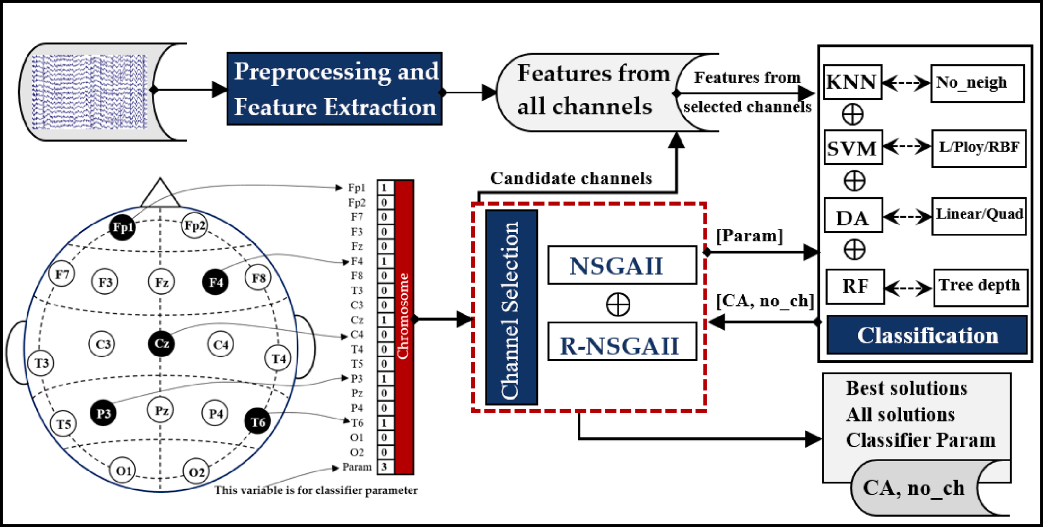
Methods
Process overview for EEG channel selection using NSGA for MCI classification
the highest full-channel accuracy (i.e., using all 19 EEG channels) is 99.51%
Aljalal, M., et al. (2024). "Mild cognitive impairment detection with optimally selected EEG channels based on variational mode decomposition and supervised machine learning." Biomedical Signal Processing and Control 87.

Slide 61
Methods
EEG data is imported and bandpass filtering in the range [0.5 Hz, 70 Hz] is done to remove environmental/muscle noise in scalp EEG. After creating epochs with a window size of 0.25 s and removing bad epochs from the data, independent component analysis (ICA) is applied, and bad channels are manually removed. The dataset is used with a sampling rate of 128 Hz, the same as during acquisition.
Accuracies of 94.68% (gender), 87.63% (age), 95.59% (two workload levels), and 89.40% (three workload levels) were achieved
This proves the effectiveness of the transformers for processing raw EEG data and can reduce the need for feature extraction in EEG .
Siddhad, G., et al. (2024). "Efficacy of transformer networks for classification of EEG data." Biomedical Signal Processing and Control 87: 105488.

Slide 62
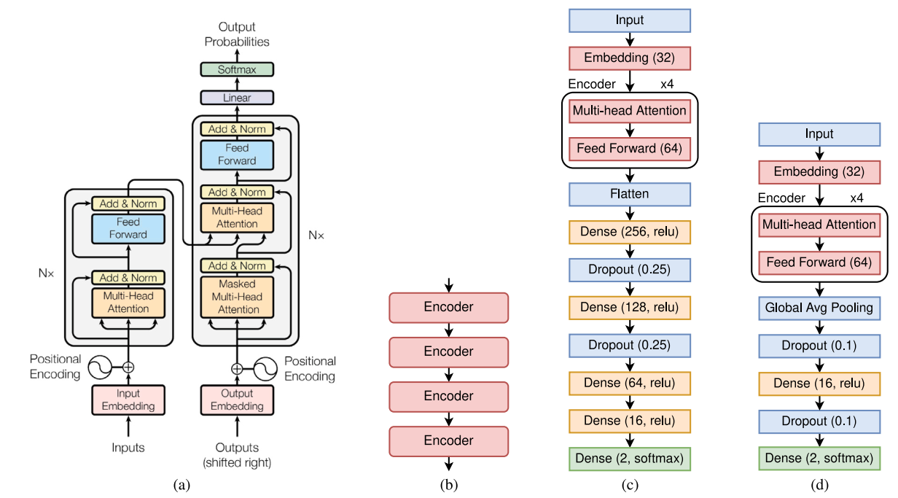
Methods
Network architecture for (a) Original transformer network [1] (left is encoder and decoder is on the right); (b) Arrangement of encoders in transformer block (stack of 4 encoders are used in the proposed method); Proposed architecture for (c) Age and Gender, and (d) STEW dataset
Siddhad, G., et al. (2024). "Efficacy of transformer networks for classification of EEG data." Biomedical Signal Processing and Control 87: 105488.

Slide 63
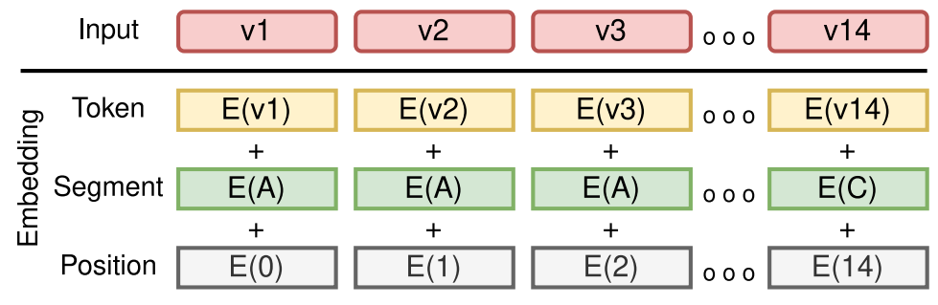
Methods
This figure shows the working of embedding and positional encoding. E with numbers represents the position embedding, E with different alphabets represents different segments, and E with various v represents the token vectors for the input. These are sum together to produce the input for the transformer network
Siddhad, G., et al. (2024). "Efficacy of transformer networks for classification of EEG data." Biomedical Signal Processing and Control 87: 105488.

Slide 64
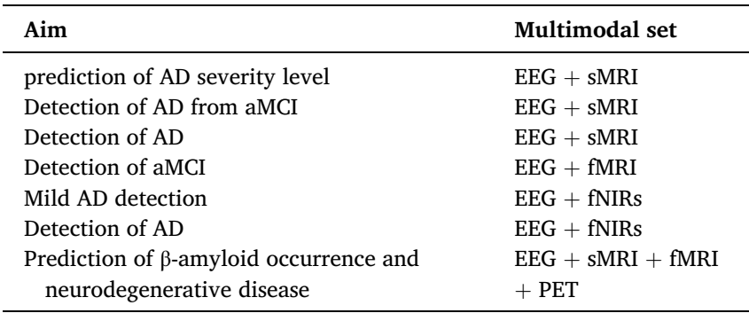
Methods
Multimodal neuroimaging system and their aim in AD assessment
Modir, A., et al. (2023). "A systematic review and methodological analysis of EEG-based biomarkers of Alzheimer's disease." Measurement 220.

Slide 65
Methods
An intriguing rsEEG application is the monitoring and evaluation of AD progression in large populations with few electrodes in low-cost devices. Clinical and rsEEG data acquired in hospital settings (10-20 montage) from 75 ADMCI participants and 70 age-, education-, and sex-matched normal elderly controls (Nold) were available in an Italian-Turkish archive (PDWAVES Consortium; www.pdwaves.eu). Standard spectral fast fourier transform (FFT) analysis of rsEEG data for individual delta, theta, and alpha frequency bands was computed from 6 monopolar scalp electrodes to derive bipolar C3-P3, C4-P4, P3-O1, and P4-O2 markers. The ADMCI group showed increased delta and decreased alpha power density at the C3-P3, C4-P4, P3-O1, and P4-O2 bipolar channels compared to the Nold group. Increased theta power density for ADMCI patients was observed only at the C3-P3 bipolar channel. Best classification accuracy between the ADMCI and Nold individuals reached 81% (area under the receiver operating characteristic curve) using Alpha2/Theta power density computed at the C3-P3 bipolar channel. Standard rsEEG power density computed from six posterior bipolar channels characterized ADMCI status.
Tucci, F., et al. (2023). "What a single electroencephalographic (EEG) channel can tell us about Alzheimer's disease patients with mild cognitive impairment." Alzheimer's & Dementia 19(S2): e062375.

Slide 66
Methods
. We used rsEEG data in Nold and ADMCI patients from an international database (www.pdwaves.eu) and performed a standard spectral FFT analysis of rsEEG activity at individual delta, theta, and alpha frequency bands.
To evaluate the study hypotheses, clinical, neuropsychological, anthropometric, genetic, cerebrospinal fluid (CSF), MRI, and rsEEG data in 70 Nold and 75 ADMCI subjects from an international archive were used in the present study. The following Italian and Turkish clinical units enrolled the participants: the Sapienza University of Rome (Italy), Institute for Research and Evidence-based Care (IRCCS) “Fatebenefratelli” of Brescia (Italy), IRCCS SDN of Naples (Italy), IRCCS Oasi Maria SS of Troina (Italy), IRCCS Ospedale Policlinico San Martino and DINOGMI (University of Genova, Italy), Hospital San Raffaele of Cassino (Italy), IRCCS San Raffaele Pisana of Rome (Italy) and Medipol University of Istanbul (Turkey).
Tucci, F., et al. (2023). "What a single electroencephalographic (EEG) channel can tell us about Alzheimer's disease patients with mild cognitive impairment." Alzheimer's & Dementia 19(S2): e062375.

Slide 67
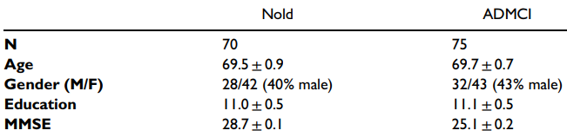
Methods
Demographic and clinical data in Nold and ADMCI
Tucci, F., et al. (2023). "What a single electroencephalographic (EEG) channel can tell us about Alzheimer's disease patients with mild cognitive impairment." Alzheimer's & Dementia 19(S2): e062375.

Slide 68
Methods
To this aim, we included the clinical and rsEEG data from an international archive acquired in hospital settings (10-20 electrode montage) from 75 ADMCI participants and 70 age-, education-, and sex-matched Nold seniors. Standard spectral FFT analysis of rsEEG data for individual delta, theta, and alpha frequency bands was computed from 6 monopolar scalp electrodes to derive bipolar C3-P3, C4-P4, P3-O1, and P4-O2 spectral markers. The ADMCI group showed increased delta power density and decreased alpha power density at the C3-P3, C4-P4, P3-O1, and P4-O2 bipolar channels. Increased theta power density for ADMCI patients was observed only at the C3-P3 bipolar channel. Best classification accuracy between the ADMCI and Nold individuals reached 81% (area under the receiver operating characteristic curve) using Alpha2/Theta power density computed at the C3-P3 bipolar channel.
Tucci, F., et al. (2023). "What a single electroencephalographic (EEG) channel can tell us about Alzheimer's disease patients with mild cognitive impairment." Alzheimer's & Dementia 19(S2): e062375.

Slide 69
Methods
The author(s) disclosed receipt of the following financial support for the research, authorship, and/or publication of this article: This work was supported by the Ministero della Salute, (grant number Ricerca Corrente” )
Tucci, F., et al. (2023). "What a single electroencephalographic (EEG) channel can tell us about Alzheimer's disease patients with mild cognitive impairment." Alzheimer's & Dementia 19(S2): e062375.

Slide 70
Methods
In this paper, two different deep learning (DL) architectures, including modified convolutional (CNN) and convolutional autoencoder (Conv-AE) neural networks (NNs), are proposed for classifying subjects into AD, mild cognitive impairment (MCI), and healthy control (HC)
Continuous wavelet transform (CWT) with Mexican hat function (MHf) as its mother wavelet is used for the selected TFR
The average accuracy obtained for the modified convolutional network and the convolutional auto-encoder network are 92% and 89%, respectively
Fouladi, S., et al. (2022). "Efficient Deep Neural Networks for Classification of Alzheimer’s Disease and Mild Cognitive Impairment from Scalp EEG Recordings." Cognitive Computation 14(4): 1247-1268.

Slide 71
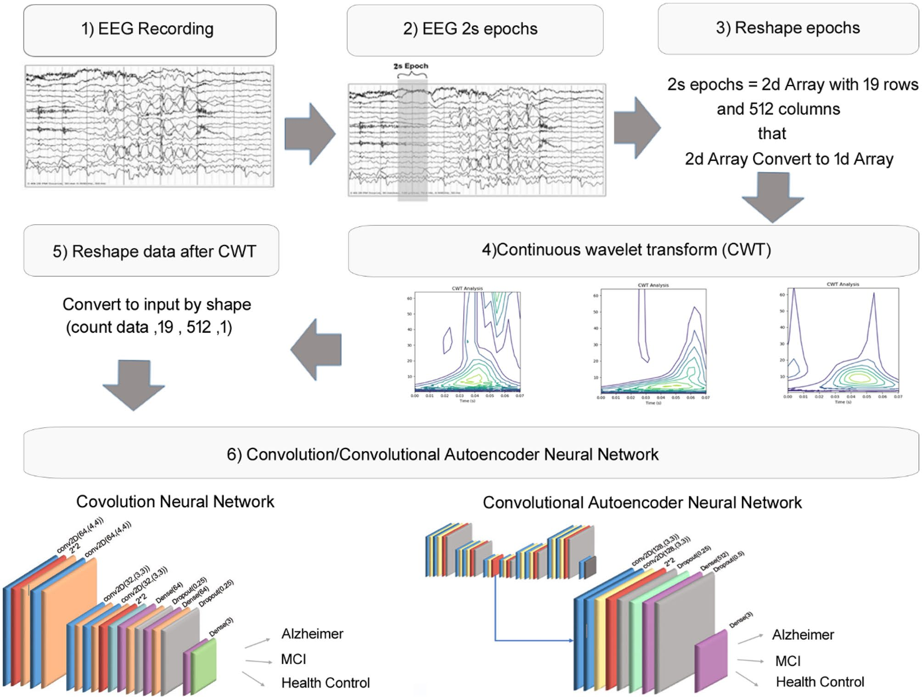
Methods
19-channel
90 subjects
37 AD
37 MCI
16 HC
recorded in 5-m
Fouladi, S., et al. (2022). "Efficient Deep Neural Networks for Classification of Alzheimer’s Disease and Mild Cognitive Impairment from Scalp EEG Recordings." Cognitive Computation 14(4): 1247-1268.

Slide 72
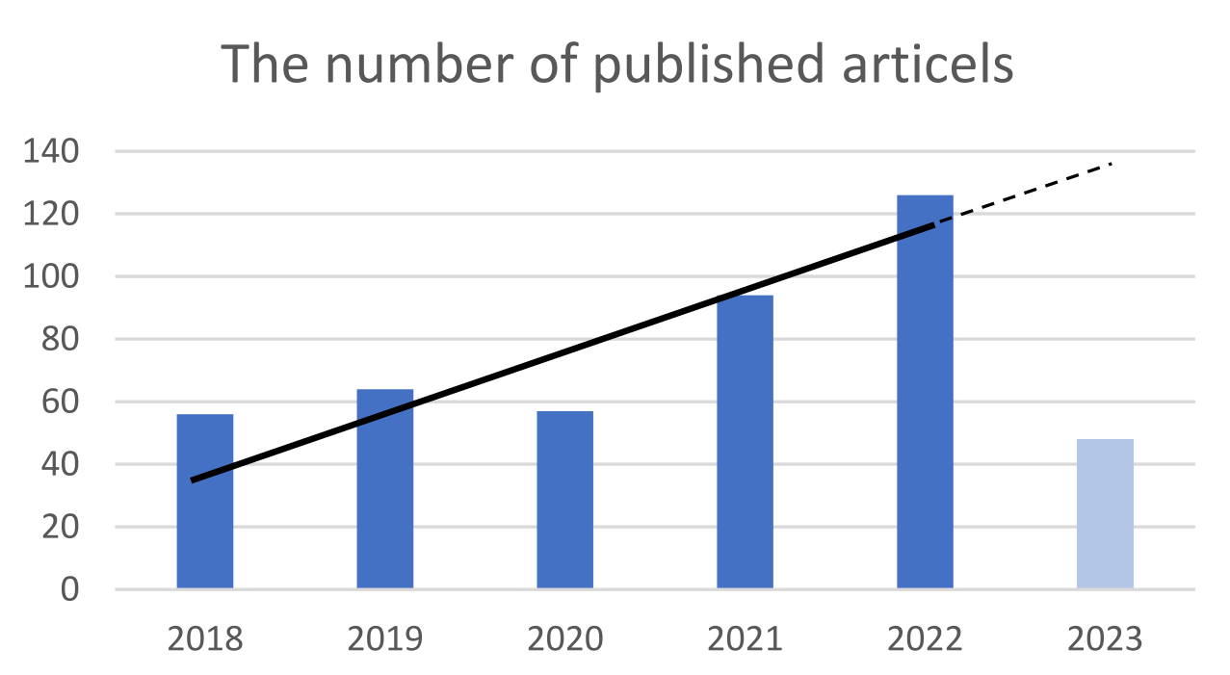
Introduction
AD diagnosis methods

Slide 73
Introduction
Dataset
the need to provide an open-access and proper EEG database for the problems in the realm of AD disease is clearly observed.Although an open-access MRI and fMRI database exists in the field of AD it is not available for EEG to the best of our knowledge
Almost all the researchers applied their own database and it makes the comparison among the performance of studies very challenging

Slide 74
Introduction
Dataset
More than 95% of the studies that focused on EEG-based classification were conducted with fewer than 100 participants.
public medical imaging databases like ADNI or OASIS is a common practice in AD literatures
in EEG studies, due to the high accessibility of this technique, researchers generally acquire their own data
the number of subjects varies across different studies, from 11 to 336. Only 13 out of 72 studies consist of more than 100 participants, therefore most of these studies have a relatively small number of participants which could limit their generalizations

Slide 75
Future Works
Evaluate the effectiveness of EEG techniques in diagnosing different types of dementias
Longitudinal studies to assess whether EEG biomarkers can be used to trace the progress trajectory of AD or evaluate the efficacy of pharmacological/therapeutic interventions for AD patients.
the model’s accuracy can be further improved using regularization techniques
interpretability

Slide 76
Future Works
other neurological disorders, such as Parkinson’s, epilepsy, and stroke, to diagnose and classify various diseases
In transformer model improvement of the proposed model, which could include the application of a spatial attention module on the EEG channels, is worth exploring
study of new features that support the early detection of AD

Slide 77
Future Works
There have been many studies on EEG analysis using machine learning techniques to detect various neurological conditions, such as Parkinson’s disease (PD), major depressive disorder, autism spectrum disorder (ASD), epilepsy, AD, schizophrenia, and and emotion recognition as well
introducing an EEG-based biomarker or a combined biomarker consisting of EEG and other neuroimaging techniques is more valuable than the others in the category of the detection and automatic classification of these three stages of AD.

Slide 78
Future Works
it is suggested to develop a novel deep neural network architecture that automatically explains its reason for each output prediction. In this case, physicians and health providers are convinced to use them and trust them for decision-making

Slide 79
References
Molecular Biology, Not Only for Bioinformaticians. Istrail, 2013
From sequence to function through structure: Deep learning for protein design
NoeliaFerruz -2023

Slide 80
Thank You

